Slide 1
Version Control Management
Aaron Pope

Slide 2

About Me

Slide 3
User Experience
What is it?
  How the user interacts
  What content the user receives
  Visuals

Slide 4
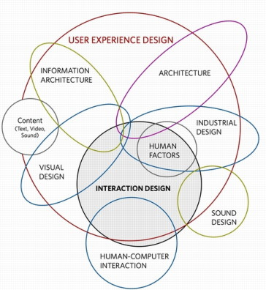
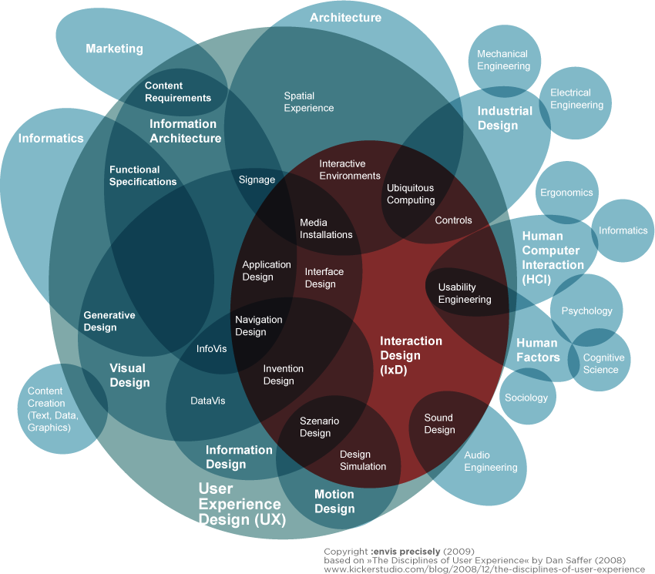
And What Else…?
http://mogensense.com/images/medialab/infographics/Interaction-Design-Disciplines2.png
http://www.pagantuna.com/images/ux-and-it.jpg

Slide 5
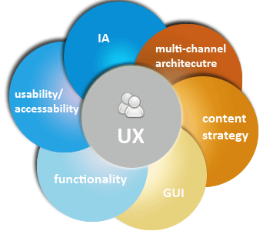
Consolidating These Areas
These core areas drive Usability and UX
http://www.o-media.ca/omedia/media/imgs/content%20images/UX.png

Slide 6
Core Areas
Architecture
  How the system works internally
Content
  Is the experience engaging?

Slide 7
Core Areas
GUI
  Is usage intuitive?
  Are navigation options clear?
  Are there “emergency exits”?

Slide 8
Core Areas
Usability
  Does the system do what the user needs it to do?
  The first time? Every time?
Functionality
  Does the system actually perform the action the user desires?

Slide 9
Why?
Users aren’t going to come back to a tool they don’t think they need
Must consider all Core Areas to avoid this

Slide 10
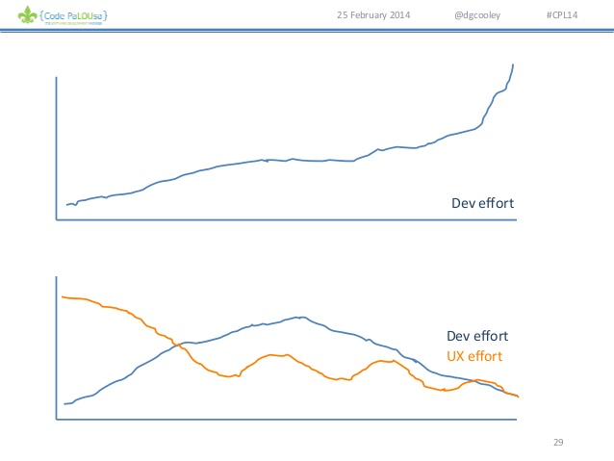
And?

Slide 11
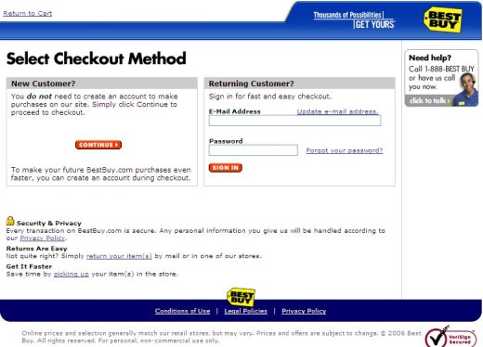
$$$
http://www.elavision.com/images/work_bby1_entry_bg.jpg

Slide 12

Went from bottom quartile to top quartile in 2004 Customer Experience Ranking
~$300,000,000
Best Buy®

Slide 13
UX Starts Early
Research
  Interviews / Surveys
  Focus Groups
  Analytics
Bottom Line: Find out what the user wants- not what you think they want!

Slide 14
Use That Information!
Simple Principles
  KISS
  3-Year-Old Rule
  30 Second Rule

Slide 15
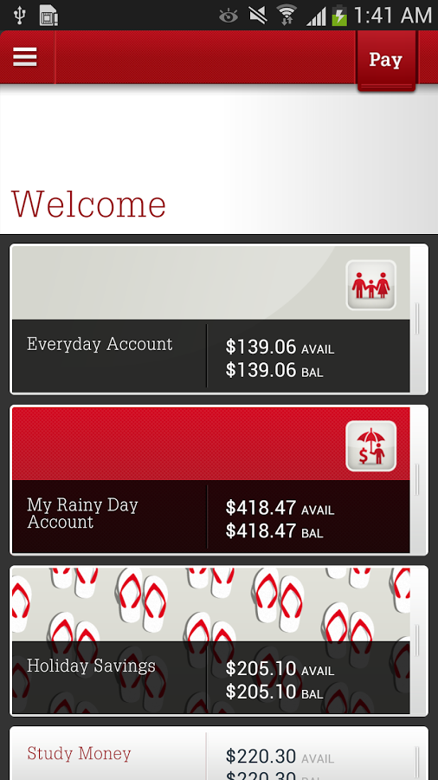
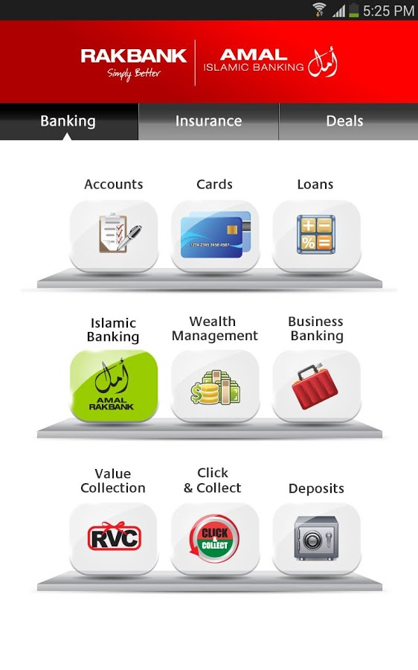
Use the Information!
-vs-
https://lh6.ggpht.com/WGSeVFofQVUNbXNybSMntu7UFCN5G8j3BKi1OVbja7axzJufvgzOyMo6uyoaKoZ0mA=h900
https://lh6.ggpht.com/1G3PE2OINIkNbvNO_1-Nhg8T1XyWPJ0GwfNNBSKtmE5_j-g4NK9lNMi71bWKJICYWk=h900

Slide 16
Current Trends
Mobile-First
  1.2 billion mobile web users

Slide 17
Current Trends
“Less is not more”
The Internet of Things
Social media is still strong

Slide 18
In Sum
UX is more than what the user sees
How they interact
How it makes them feel
The lasting impression
It’s a Holistic Experience

Slide 19

Sources (list them)
http://www.google.com
http://www.elavision.com/work_bby1.html
http://www.slideshare.net/dgcooley/the-business-case-for-ux-code-palousa-2014
http://www.slideshare.net/dgcooley/avoiding-ui-mistakes-code-palousa-2014
http://designshack.net/articles/css/mobilefirst/

